Slide 1
FIFA WORLD CUP ANALYSIS
THE HISTORY OF FOOTBALL

Slide 2
Agenda
INTRODUCTION 3
COUNTRIES WITH NO. OF GOALS 4
PODIUM FINISHES 5
TOP 10 COUNTRIES 6
FINAL OUTCOME 11

Slide 3
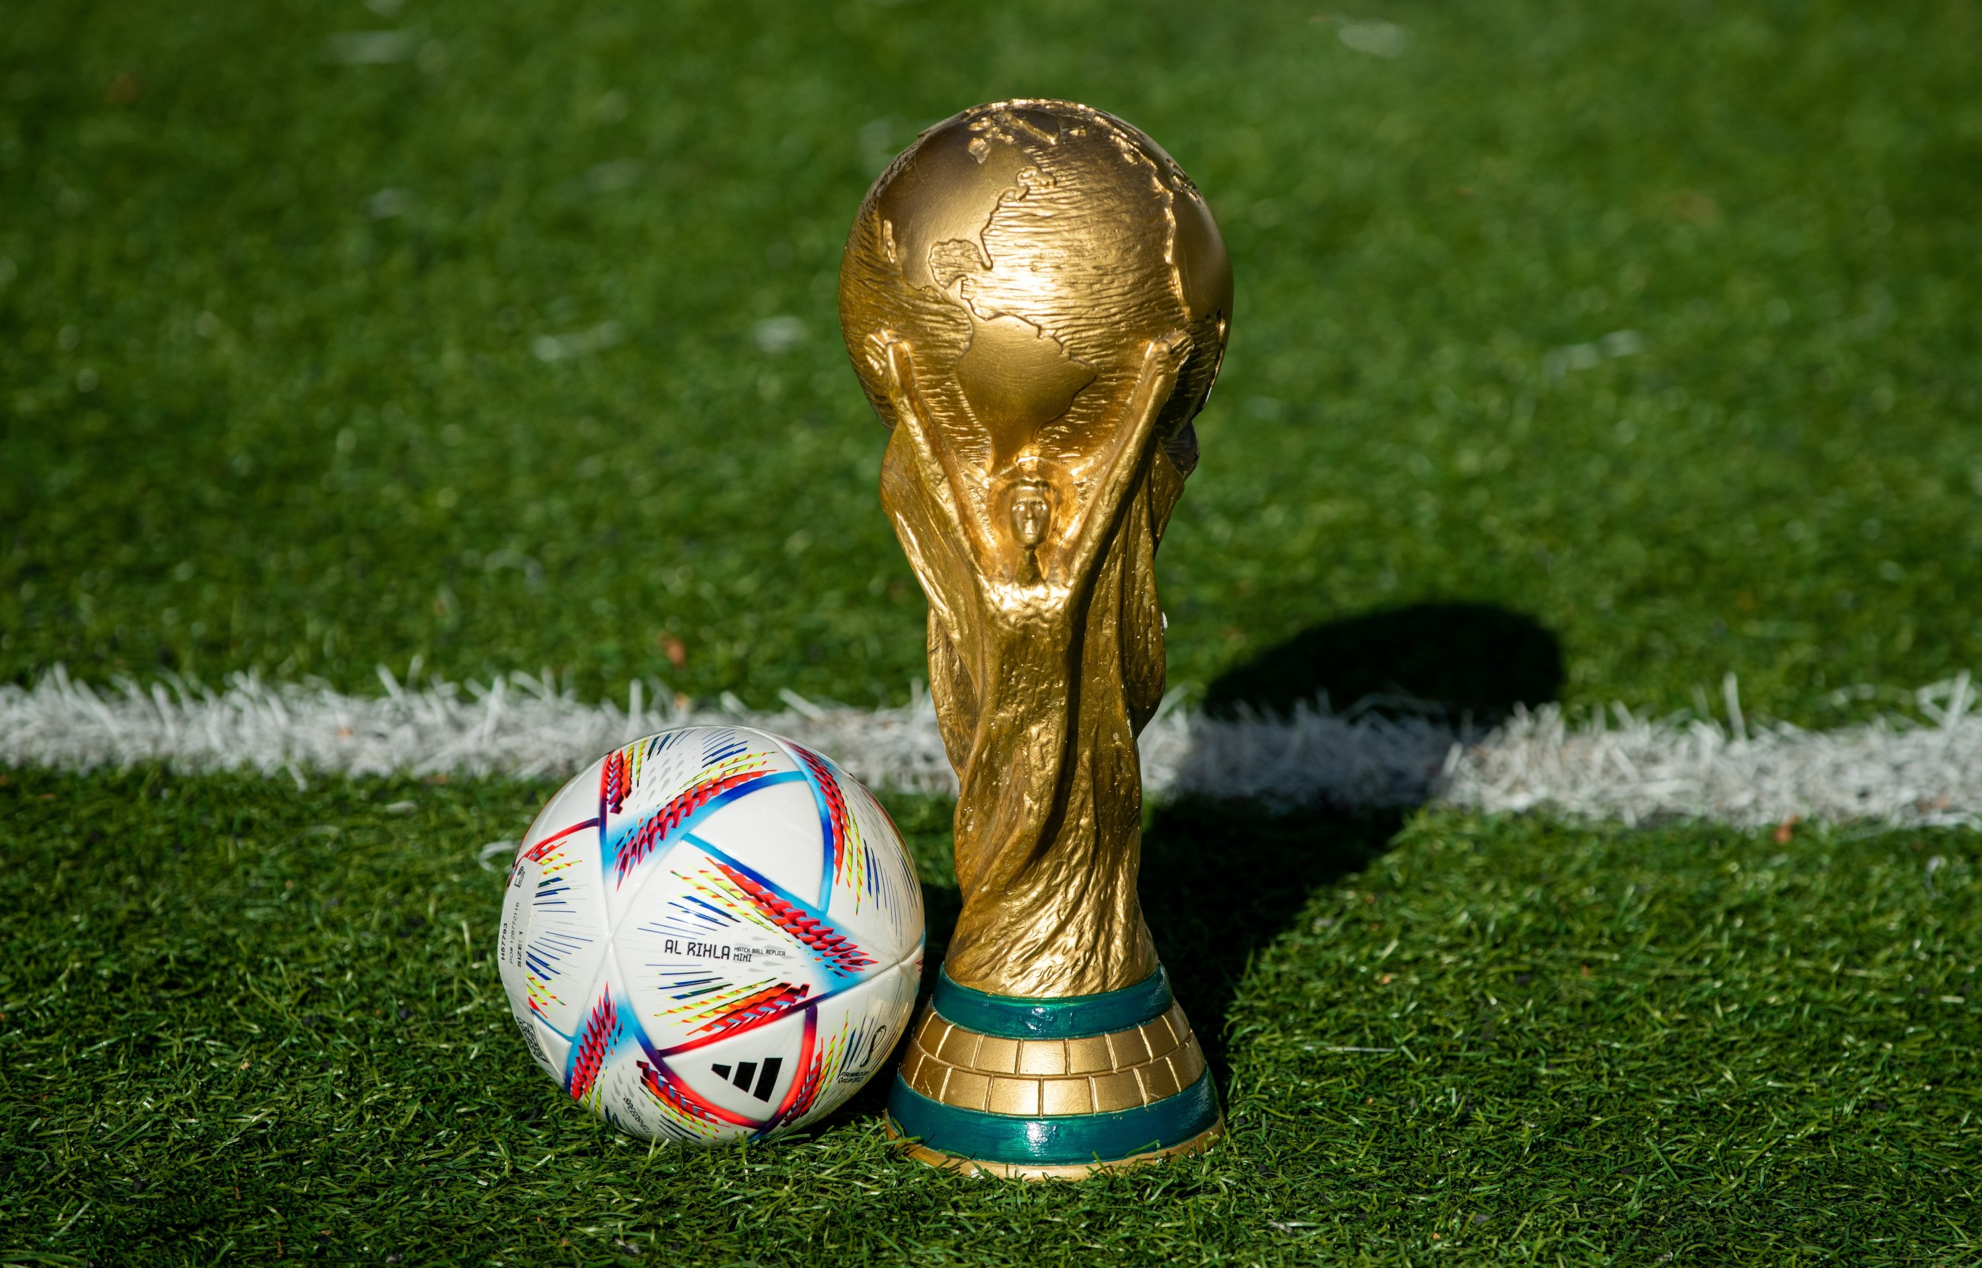
The FIFA World Cup is the most prestigious international football (soccer) tournament in the world. Organized by the Fédération International de Football Association (FIFA), the tournament brings together national teams from across the globe to compete for the title of world champion.

Slide 4
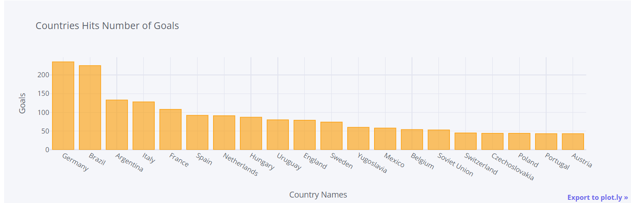
Countries with Number of Goals

Slide 5
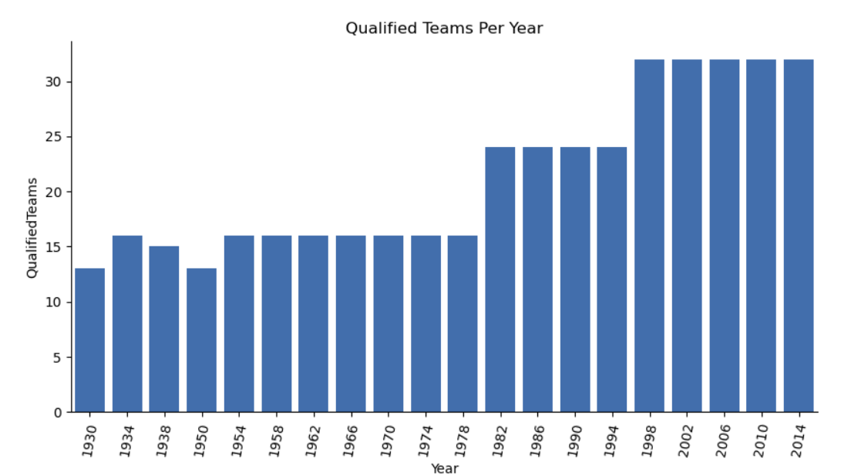
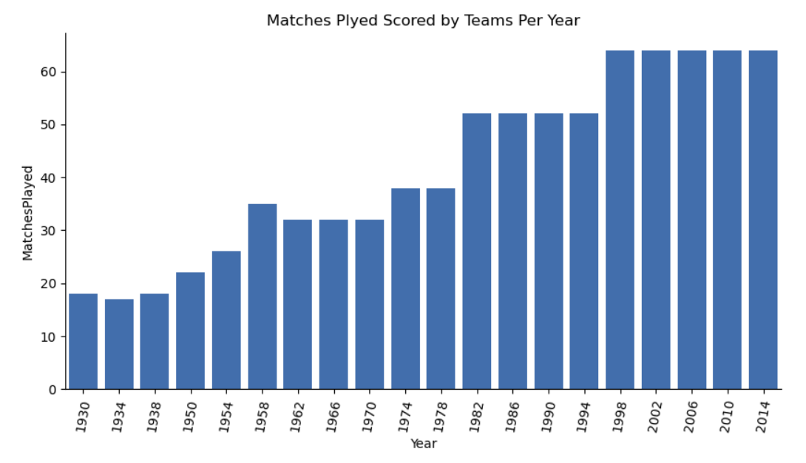
It is inferred that about 13 teams were qualified in the year 1930.
But as per the latest data of 2014, it can be observed that since year 1998-2014,more than 30 teams are qualified in the game.
In the 19’s ,there were almost 15-50 matches played by the teams, but in 2002-2014 the number of matches played were more than 60.

Slide 6
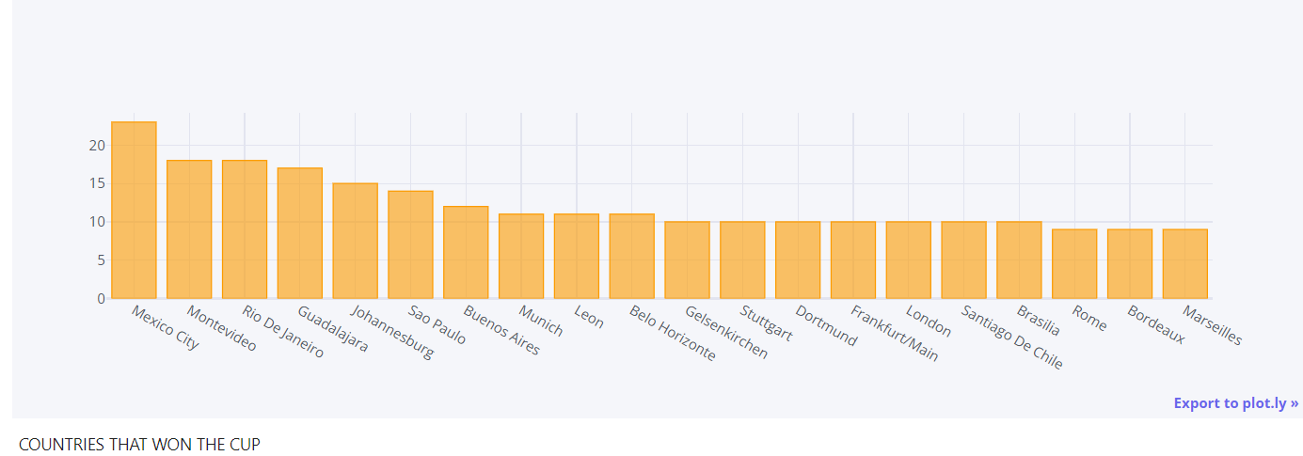
COUNTRIES THAT WON THE WORLD CUP
Top Cities: Mexico City has the highest count, followed by Montevideo, Rio De Janeiro, and Guadalajara, indicating these cities have a prominent history with the World Cup, either by hosting or related events.
Distribution: There is a gradual decline in the number of wins/hosting events as we move from left to right in the chart, suggesting a few cities have been more dominant in the World Cup's history.

Slide 7
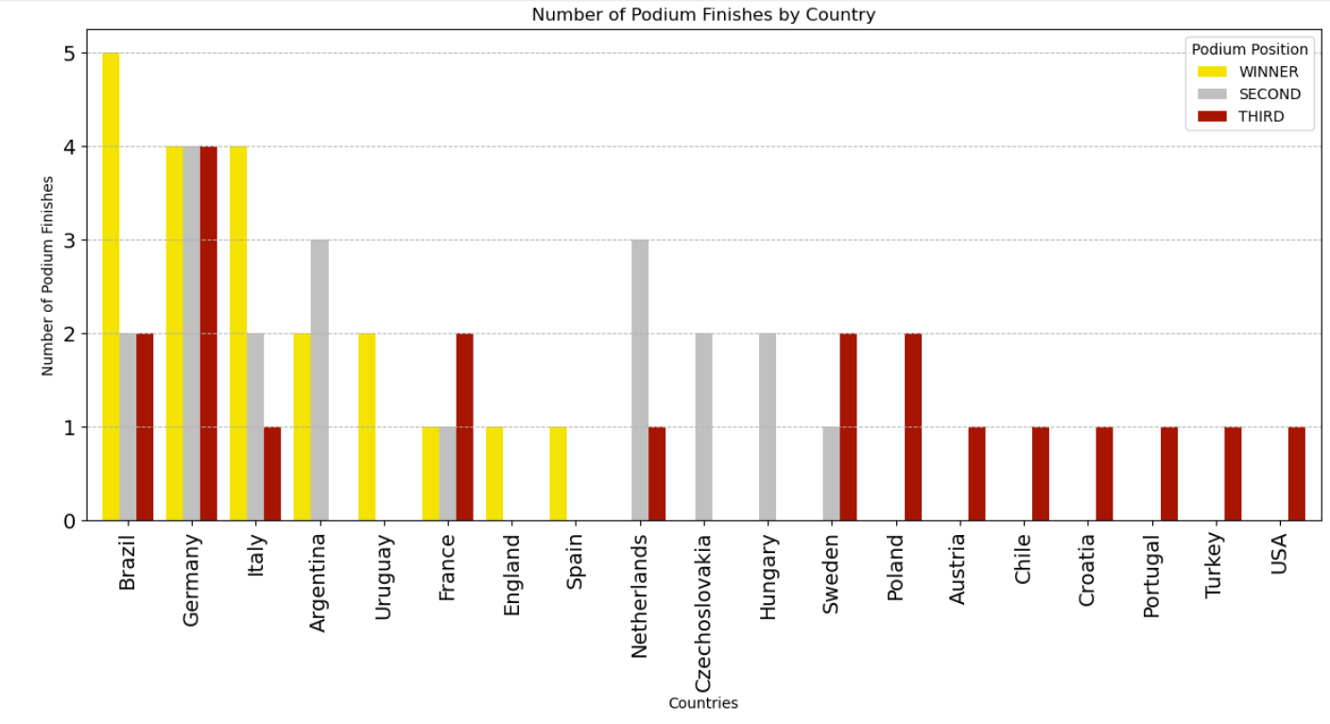
PODIUM FINISHES

Slide 8
1. Top Performing Countries:
Brazil: Has the highest number of podium finishes with 5 wins (indicated in yellow).
Germany: Shows strong performance with 4 wins and a balanced distribution of second (gray) and third (red) places.
Italy: Has a notable number of wins and third places.
2. Consistent Podium Placers:
Argentina, Uruguay, France: These countries have a mix of wins and second or third places.
Netherlands: Notable for multiple second and third-place finishes, but no wins.
3. Other Countries:
Czechoslovakia, Hungary, Sweden, etc.: These countries mainly have a few second and third-place finishes, suggesting they have reached the podium but haven't won as frequently.
4. Visual Insights:
Winners (Yellow): Countries with yellow bars indicate wins, with Brazil leading.
Second Place (Gray): Countries with gray bars show the number of times they finished second, with the Netherlands being a prominent example.
Third Place (Red): Countries with red bars indicate third-place finishes, which is more common among a larger number of countries like Poland, Austria, Chile, etc.
This chart gives a comprehensive view of the distribution of podium finishes across different countries, highlighting both the dominant nations in terms of wins and those that have consistently placed in the top three.

Slide 9
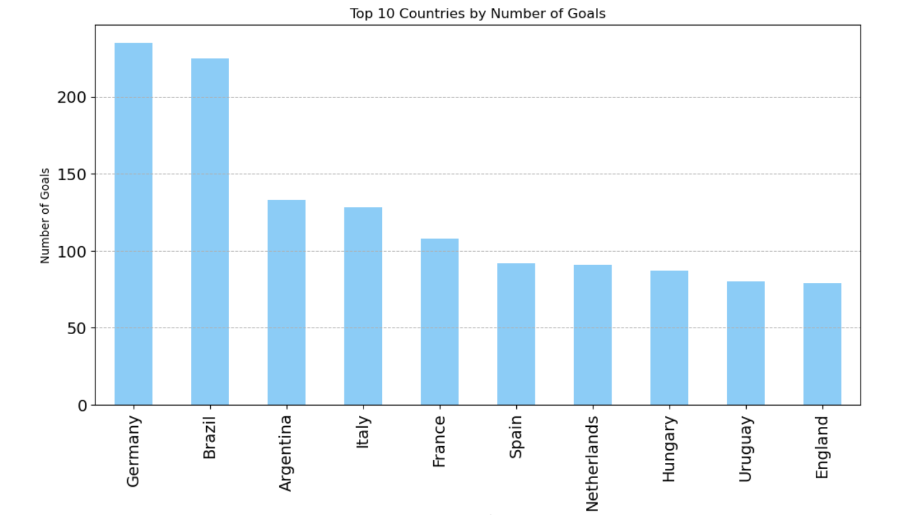
TOP 10 COUNTRIES

Slide 10
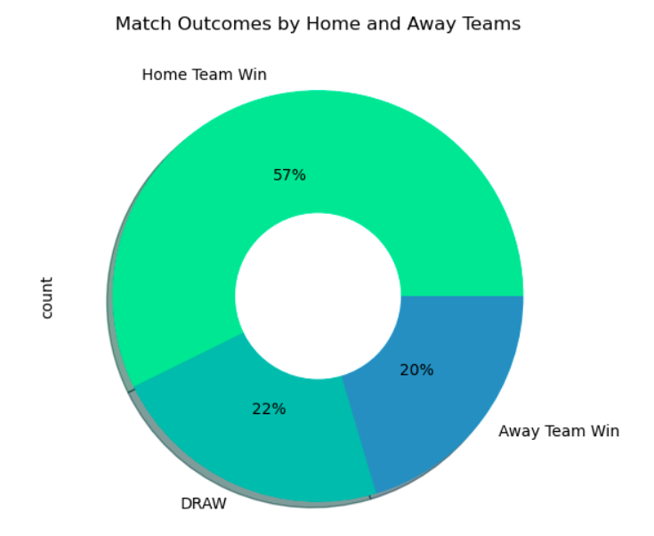
RESULTS & OUTCOMES
This donut chart illustrates the outcomes of matches based on whether the home team won, the away team won, or if the match ended in a draw. Here's a detailed analysis:
1. Home Team Wins:
The largest portion of the chart, accounting for 57% of the total outcomes.
Indicates that playing on home turf provides a significant advantage in match outcomes.
2. Away Team Wins:
Represents 20% of the total match outcomes.
Shows that away teams have a smaller probability of winning, potentially due to factors like travel fatigue, unfamiliar environments, and crowd support for the home team.
The data suggests a clear advantage for home teams, as they win more than half of the matches.
Draws occur more frequently than away team wins, showing that when the home team doesn’t secure a win, a draw is more likely than an away victory.

Slide 11
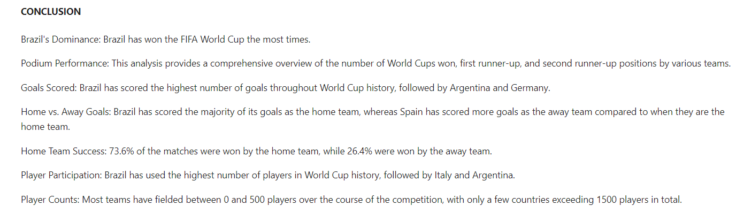
speaking impact
Learn to infuse energy into your delivery to leave a lasting impression
One of the goals of effective communication is to motivate your audience
METRIC | MEASUREMENT | TARGET | ACTUAL
Audience attendance | # of attendees | 150 | 120
Engagement duration | Minutes | 60 | 75
Q&A interaction | # of questions | 10 | 15
Positive feedback | Percentage (%) | 90 | 95
Rate of information retention | Percentage (%) | 80 | 85

Slide 12
Thank you

